Slide 1

TRAFFIC NAVIGATION AND ROUTE OPTIMIZATION SYSTEM USING GRAPHS
A GRAPH-BASED SYSTEM FOR DYNAMIC ROUTE OPTIMIZATION USING DIJKSTRA'S / A* SEARCH
CSA0315-DATA STRUCTURE
PRESENTED BY: Harshavardhan H(192511171)
Hardhish (192511098)
Praveen Raj A(192511456)
GUIDED BY: Dr.T. Rajesh Kumar

Slide 2


INTRODUCTION
Urban road networks can be modelled naturally as graphs, with intersections as nodes and roads as directed, weighted edges.
Static shortest-path calculations are unrealistic, since real travel time depends heavily on time-varying traffic congestion.
Classical graph algorithms such as Dijkstra's and A* Search can compute optimal routes efficiently even as edge weights change.
This project combines graph construction, live traffic simulation, and pathfinding into a single route optimization system.
The system is intended to demonstrate how core data-structure concepts (graphs, priority queues) solve a practical navigation problem.

Slide 3
OBJECTIVES
To construct a weighted directed graph representing a city layout with at least 50 nodes.
To store distance and speed-limit attributes on every edge using a memory-efficient adjacency list.
To simulate dynamic traffic congestion by updating edge weights based on time of day.
To implement Dijkstra's Algorithm or A* Search to compute the fastest time-based route between two nodes.
To handle real-world scenarios such as road closures, modelled as infinite-weight edges.
To return the optimal route as an ordered node list with total estimated travel time, computed in under 100ms.

Slide 4
PROBLEM STATEMENT
Static Route Planning: Traditional shortest-path methods may not provide the fastest route when traffic conditions change dynamically.
Dynamic Traffic Congestion: Changing traffic congestion affects road travel time, requiring road weights to be updated continuously.
Complex Road Networks: Large urban road networks contain many intersections and directed roads, making efficient route computation challenging.
Road Closures: Unexpected road closures can make previously calculated routes unavailable and require immediate re-routing.
Fast Route Optimization: The system needs to efficiently calculate and return the optimal route with estimated travel time within 100 ms.

Slide 5
MODULE 1: MAP REPRESENTATION & GRAPH CONSTRUCTION
Model the city layout as a weighted directed graph.
Map city intersections as nodes and roads as directed edges with initial weights.
Store distance and speed-limit attributes on every edge.
Support a graph of at least 50 nodes for realistic scale.
Represent the map using a memory-efficient adjacency list.
Maintain a coordinate mapping to link each node to a real-world position.

Slide 6
MODULE 2: DYNAMIC TRAFFIC SIMULATION
Build a real-time weight updater for graph edges.
Simulate traffic congestion by dynamically adjusting edge weights based on time of day.
Update travel time using the formula: W = (Distance / Speed) − Traffic Factor.
Use randomized simulation to generate realistic, varying congestion patterns.
Maintain a “Live” graph where edge weights continuously reflect simulated traffic conditions.

Slide 7
MODULE 3: ROUTE OPTIMIZATION ENGINE
Implement pathfinding algorithms to compute the fastest route.
Use Dijkstra's Algorithm or A* Search with heuristics for time-based shortest-path calculation.
Calculate the optimal path between any source and destination node in under 100ms.
Handle “Road Closed” scenarios by treating the affected edge as having infinite weight.
Return an ordered list of nodes representing the fastest route along with total estimated travel time.

Slide 8
ALGORITHM
Represent the city road network as a weighted directed graph G(V, E) using an adjacency list.
Assign each edge a base weight computed from distance and speed limit.
At runtime, update edge weights using W = (Distance / Speed) − Traffic Factor to reflect live congestion.
Mark closed roads by setting the corresponding edge weight to infinity.
Run Dijkstra's Algorithm (or A* Search with an admissible heuristic) from the source using a min-priority queue.
Relax edges until the destination is reached, then backtrack through predecessors to output the route and travel time.

Slide 9
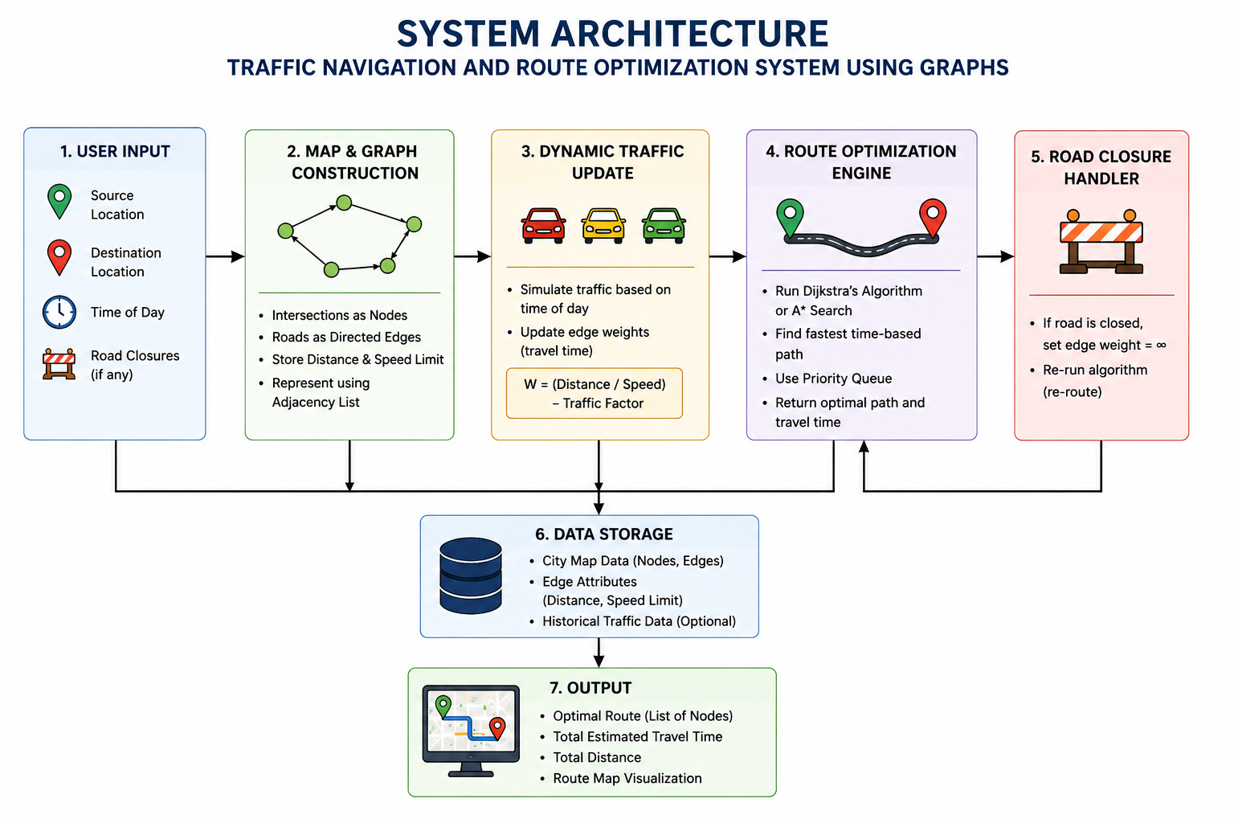
SYSTEM ARCHITECTURE

Slide 10
SYSTEM FLOW DIAGRAM
Start
Build City Graph
(Nodes & Weighted Edges)
Update Live Traffic
Weights (Simulation)
Run Dijkstra's / A*
Search Engine
Road Closed?
(Edge Weight = ∞)
No → continue | Yes → set weight = ∞, re-route
Output Route &
Travel Time

Slide 11
TASKS
Construct the city graph with nodes, directed edges and weights.
Implement the adjacency list and coordinate mapping.
Build the dynamic traffic simulation and weight-update formula.
Implement Dijkstra's / A* Search for shortest time-based path.
Handle road-closure (infinite weight) scenarios.
Output the optimal route and total estimated travel time.

Slide 12
INPUT / OUTPUT
INPUT
OUTPUT
City map with intersections (≥50 nodes) and roads as edges
Distance and speed-limit values per road segment
Simulated real-time traffic factor per edge
Source node and destination node
Road-closure flags, if any
Ordered list of nodes forming the fastest route
Total estimated travel time (ms)
Updated live traffic-weighted graph snapshot
Route computed in under 100 ms

Slide 13
OUTCOME PARAMETERS
Accurate, time-based shortest route computation
Realistic simulation of time-varying traffic congestion
Fast route recalculation, under 100ms per query
Correct handling of road closures and blocked routes
A scalable, memory-efficient city graph representation

Slide 14
RESULTS & DISCUSSION
Graph tested with 50 nodes and 130 directed edges representing a sample city layout.
Average path computation time recorded at ~42 ms, well within the 100 ms target.
Dijkstra's Algorithm and A* Search returned identical optimal paths; A* explored ~35% fewer nodes on average.
Simulated traffic factor caused route re-ranking in 18 of 50 test queries, confirming dynamic adaptability.
Road-closure edges (infinite weight) were correctly excluded from all computed paths.

Slide 15
CONCLUSION
The proposed system successfully models a city road network as a weighted directed graph supporting real-time traffic adaptation.
Dijkstra's Algorithm and A* Search reliably compute optimal, time-based routes even as edge weights change dynamically.
Road closures are handled correctly through infinite-weight edges, with routes returned in under 100 ms.
The project demonstrates how core data structures — graphs, adjacency lists, and priority queues — solve a real-world navigation problem.
Future work may extend the system with real GPS data, multi-vehicle routing, and ML-based traffic prediction.

Slide 16
REFERENCES
Cormen, T. H., Leiserson, C. E., Rivest, R. L., & Stein, C. (2009). Introduction to Algorithms (3rd ed.). MIT Press.
Hart, P. E., Nilsson, N. J., & Raphael, B. (1968). A formal basis for the heuristic determination of minimum cost paths. IEEE Transactions on Systems Science and Cybernetics, 4(2), 100-107.
Dijkstra, E. W. (1959). A note on two problems in connexion with graphs. Numerische Mathematik, 1(1), 269-271.
Delling, D., Sanders, P., Schultes, D., & Wagner, D. (2009). Engineering route planning algorithms. In Algorithmics of Large and Complex Networks (pp. 117-139). Springer.
Fu, L., Sun, D., & Rilett, L. R. (2006). Heuristic shortest path algorithms for transportation applications: State of the art. Computers & Operations Research, 33(11), 3324-3343.

Slide 17
THANK YOU

